Slide 1
The Diamond & Dybvig Model Class Experiment

Slide 2
The model (recap)
At t=0, the banks takes in a deposit of 1 from all depositors; bank loans the funds to a project that matures at t=2.
At t=1, the bank promises to pay r1 to all depositors who choose to withdraw at t=1.
At t=2, the investment project matures, giving return R per unit to the bank. The remaining depositors (withdrawing late) receive all the rest of money.
Depending on the amount of early withdrawals, the return to late withdrawals might be more or less than r1.

Slide 3
Notices
Withdrawal at t=1 does not guarantee r1. If the share s of early withdrawals at t=1 is too high, the bank can only pay 1/s < r1. At the worst scenario, you only receive your original deposit (r1 = 1).
Withdrawal at t=2 does not guarantee r2>1. The bank may run out of money, because a lot has been paid to withdrawal requests at t=1.
But if everybody in the room withdraws late, then r2 >r1
You aim at maximizing your return by choosing to withdraw at t = 1 or at t = 2.

Slide 4
First scenario: Few type 1 depositors
In this scenario, only 10% of depositors have type 1, that is, they must consume at t=1
The computer plays these depositors. They all withdraw at t=1
You, the students, play the 90% of depositors with type 2. You have to choose whether to withdraw at t=1 or t=2 to maximize your return.
Here, project return is R=1.5, promised return to type 1 is r1=1.06
Please make your decision now via the vote

Slide 5
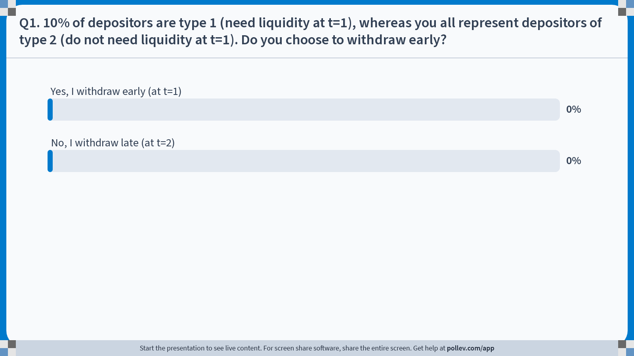
Notes:
Poll Title: Do not modify the notes in this section to avoid tampering with the Poll Everywhere activity. More info at polleverywhere.com/support Q1. 10% of depositors are type 1 (need liquidity at t=1), whereas you all represent depositors of type 2 (do not need liquidity at t=1). Do you choose to withdraw early? https://www.polleverywhere.com/multiple_choice_polls/h6jHJEoOPtWV0nScypbfh?state=opened&flow=Default&onscreen=persist

Slide 6
Second scenario: Many type 1 depositors
In this scenario, 80% of depositors have type 1, that is, they must consume at t=1
The computer plays these depositors. They all withdraw at t=1
You, the students, play the 20% of depositors with type 2. You have to choose whether to withdraw at t=1 or t=2 to maximize your return.
Again, project return is R=1.5, promised return to type 1 is r1=1.06
Please make your decision now via the vote

Slide 7

Notes:
Poll Title: Do not modify the notes in this section to avoid tampering with the Poll Everywhere activity. More info at polleverywhere.com/support Q2. 60% of depositors are type 1 (need liquidity at t=1), whereas you all represent depositors of type 2 (do not need liquidity at t=1). Do you choose to withdraw early? https://www.polleverywhere.com/multiple_choice_polls/QnraeG7WRw1ADxnOW9fpA

